Slide 1
CS 575
Design and Analysis of
Computer Algorithms
Professor Michal Cutler
Proving Correctness

Slide 2
Proving correctness
Proof based on loop invariants
  an assertion which is satisfied before each iteration of a loop
  At termination the loop invariant provides important property that is used to show correctness
Steps of proof:
  Initialization (similar to induction base)
  Maintenance (similar to induction proof)
  Termination

Slide 3
More on the steps
Initialization: Show loop invariant is true before (or at start of) the first execution of a loop
Maintenance: Show that if the loop invariant is true before an execution of a loop it is true before the next execution
Termination: When the loop terminates, the invariant gives us an important property that helps show the algorithm is correct

Slide 4
Example: Finding maximum
Findmax(A, n)
maximum = A[0];
for (j = 1; j < n; j++)
if A[j] > maximum
maximum= A[j]
return maximum
What is a loop invariant for this code?

Slide 5
Proof of correctness
Loop invariant for Findmax(A):
“before the jth iteration (for j = 1, … , n) of the for loop
maximum = max{A[i]| i = 0, …, j - 1}”

Slide 6
Initialization
We need to show loop invariant is true at the start of the execution of the for loop
Line 1 sets maximum=A[ 0] = max{A[i]|i=0,…,1-1}
So the loop invariant is satisfied at the start of the for loop (before 1st iteration).

Slide 7
Maintenance
Assume that before the jth iteration of the for loop
maximum = max{A[i] | i = 0, …, j - 1}
We will show that before the (j + 1)th iteration maximum =max{A[i] | i = 0, …, j}
The code computes
maximum=max(maximum, A[j]) =max(max{A[i] | i= 0, …, j - 1}, A[j]) = max{A[i] | i = 0, …, j}

Slide 8
Termination
j = n .
So maximum = max{A[i]|i=0,…,n - 1}

Slide 9
Insertion sort
What is the main idea?
http://www.youtube.com/watch?v=UAmaFHWBoYQ

Slide 10
Pseudo code in text
Body of a loop indicated by indentation
← for assignment
for i =1 to n is equivalent to
  for (int i =1; i < (n+1); i++)
Arrays are assumed to start at index 1,
(left over from old Fortran, Pascal)

Slide 11
Example: Insertion sort
INSERTION-SORT(A)
for j <- 2 to length[A]
key ← A[j]
// Insert A[j] into sorted A[1.. j - 1]
i ← j – 1
while i > 0 and A[i] > key
A[i + 1] ← A[i]
i <- i – 1
A[i + 1] ← key

Slide 12
Proof of correctness
Loop invariant for INSERTION-SORT(A):
“before the j th iteration (for j = 2, … , length[A]+1) of the for loop
  A[1.. j -1] contains the elements originally in A[1.. j -1] and
  A[1.. j -1] is sorted”

Slide 13
Initialization
We need to show loop invariant is true at the before the 1st execution of the for loop when j=2
We have:
  Subarray A[1.. 2 - 1]= A[1] contains the original element in A[1]
  A[1] is sorted.
So the loop invariant is satisfied

Slide 14
Maintenance
If loop invariant is true before this execution of a loop it is true before the next execution
Assume that before the jth iteration of the for loop A[1.. j -1] contains the elements originally in
A[1.. j - 1] and A[1.. j -1] is sorted

Slide 15
Maintenance
We will show that the loop invariant is maintained before the (j + 1)th iteration.
  We will show that before the (j + 1)th iteration of the for loop A[1.. j] contains the elements originally in A[1.. j] and A[1.. j] is sorted

Slide 16
Maintenance
For a more formal proof we need a loop assertion for the while loop
We will be less formal and observe that the body of the loop moves A[j - 1], A[j - 2], etc., to the right until the proper position for A[j] is found and then inserts A[j] into the sub array A[1.. j ]. So:
  the sub array A[1.. j] contains the elements originally in A[1.. j] and A[1.. j] is sorted

Slide 17
Termination
j = length[A] + 1.
The array A[1.. length[A]] contains the elements originally in
A[1.. length[A]] and
A[1.. length[A]] is SORTED!

Slide 18
Loop invariants
1. sum =0;
2. for (i = 0; i < n; i++)
3. sum = sum + A[i];
What is a loop invariant for this code?

Slide 19
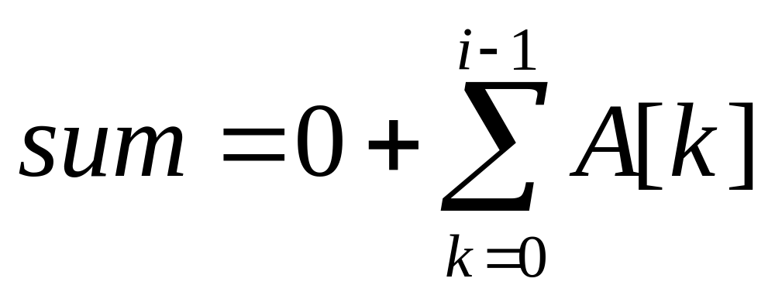
Proof of correctness
Loop invariant:
“Before the i th iteration (for i = 0, … , n) of the for loop

Slide 20
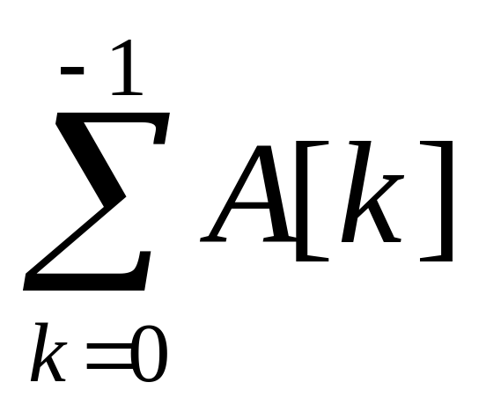
Initialization
Show loop invariant is true at the start of the execution of the for loop
Line 1 sets sum = 0 = 0+
So the loop invariant is satisfied at the start of iteration 0.

Slide 21
Maintenance
If loop invariant is true before this execution of a loop it is true before the next execution
Assume that before the ith iteration of the for loop

Slide 22
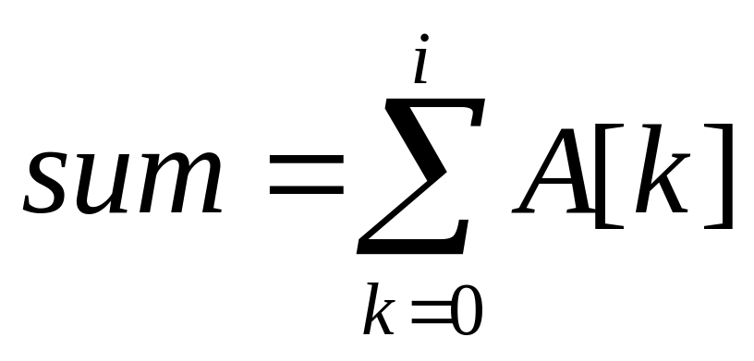
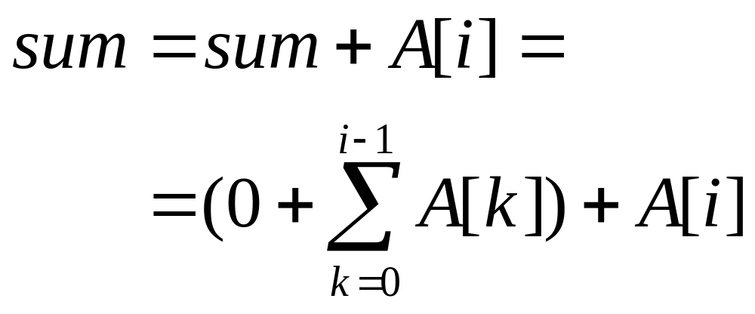
Maintenance
We will show that before the (i + 1)th iteration of the for loop
From the code

Slide 23
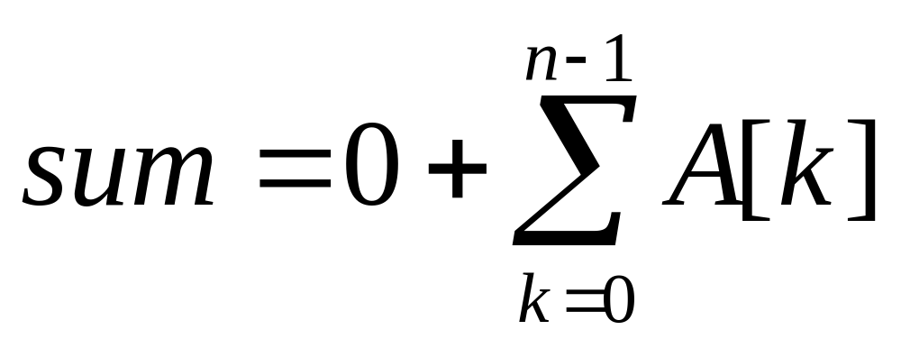
Termination
i= n
So

